Slide 1
Recap SW4a
Matthias Schwegler & Michael Weber
INTRO

Slide 2
Inhalt
Simple Events
d
Sequential State Machines
d

Slide 3
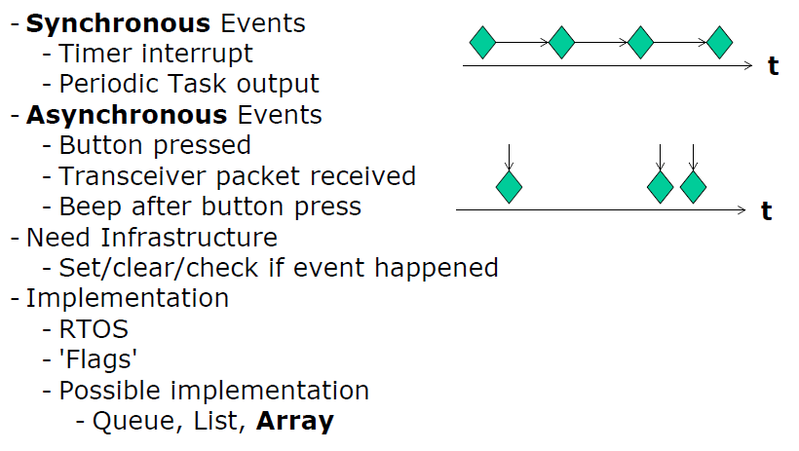
Simple Events

Slide 4
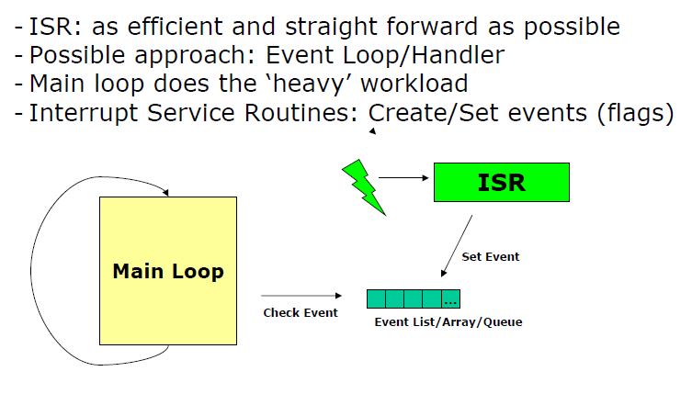
Simple Events

Slide 5
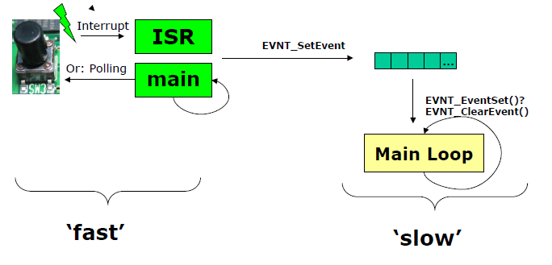
Simple Events

Slide 6
Simple Events

Slide 7
Fragen?

Slide 8
Quiz

Slide 9
Quiz - Lösungen

